Slide 1

The paperless contract
Peter Moran, Principal
Tel: 03 8623 7168
Email: peter.moran@norgled.com.au

Slide 2

Overview
Why have a paperless contract?
Paperless contracts: online terms and conditions.
Electronic Transaction Acts.
Signing paperless contracts.
Retention of paperless contracts.
Online protection including privacy.
Enforceability of paperless contracts.
Exceptions.

Slide 3
What do I mean by a paperless contract?
A paperless contract is one which is circulated, signed, exchanged and retained electronically and is never printed onto paper.
CF “translucent” contracts:
  one part of the contract has been circulated, signed, exchanged and/or retained electronically but at some point the contract is still printed onto paper.

Slide 4
Why have a paperless contract?
Quick.
Convenient.
Environmentally friendly.
Control over the circulation and signing process.
Verify identity of signatories.
Better evidence of contract.
Unalterable date stamped record, reduces risk of tampering with contract.
Easier and cheaper document retention.
Transfer of risk to software providers.
Increasing client demand (e-signing sector has been estimated as a $5 billion industry).

Slide 5
Why not have a paperless contract?
Potential unenforceability (eg exceptions under Electronic Transactions Acts).
Ceremony of signing.
Document retention concerns/security of contracts.
No clear process for how to sign electronically (ie most people would still print, sign and scan, so not really paperless at that point).
Don’t get to show off pretty firm covers.
Fear of the unknown / if it ain’t broke, don’t fix it / this is how I’ve always done it.

Slide 6
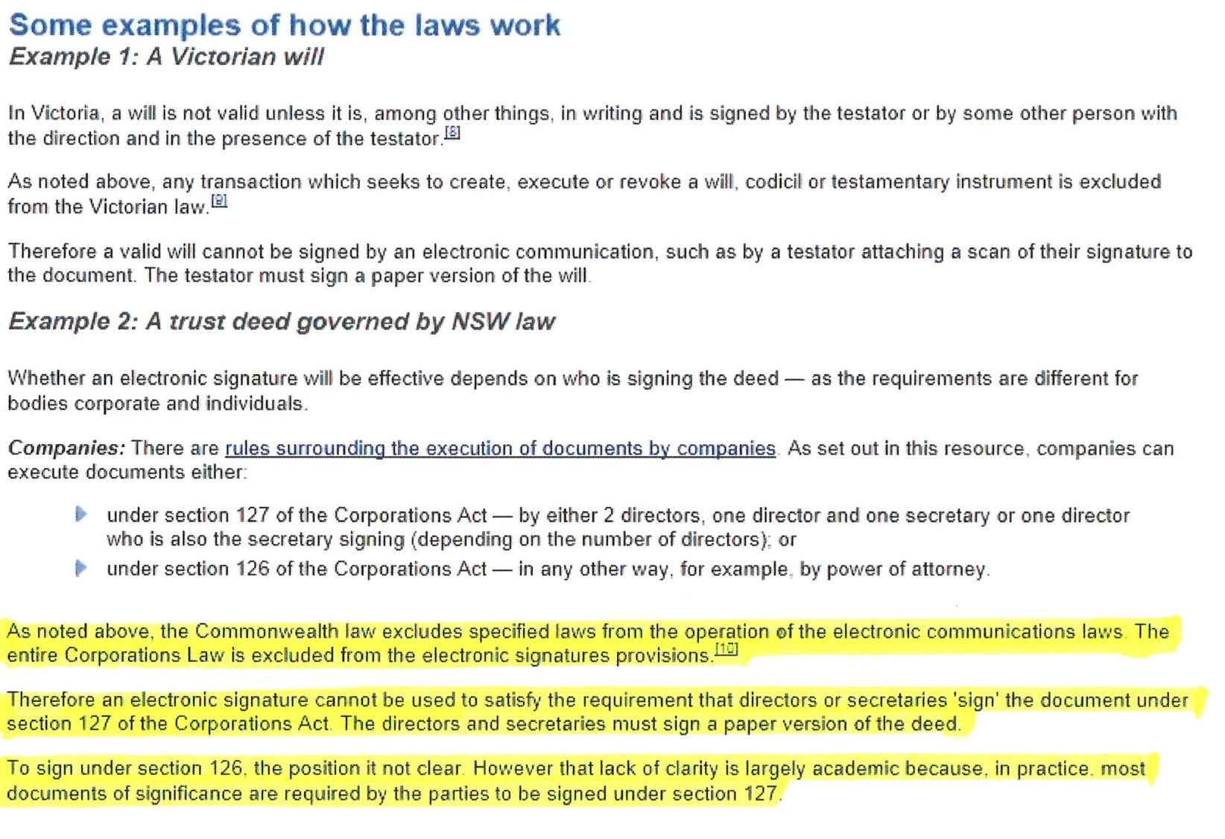
Fear of the unknown

Slide 7
Online terms and conditions – web/software development
Getting in and out.
Alterations – agreed process.
Acceptance Tests.
IP.
Escrow.
Ongoing maintenance obligations.
AWIA – Widelines for web development agreements (www.widelines.org).

Slide 8
Online terms and conditions
Shrink wrap agreements – a form of licence to use software. Becoming less common thanks to SaaS/cloud.
Click wrap (or click through) agreements – where user accepts terms and conditions by clicking on button (see eBay International Ag v Creative Festival Entertainment Pty Ltd [2006] FCA 1768).
Browse wrap agreements - where user has opportunity to go to terms and conditions.
Did the user have “reasonable notice of and manifested assent to the online agreement” – Burcham v Expedia, Inc 2009 WL 586513. See also the Unfair Contract terms of the Australian Consumer Law (pt 2-3).

Slide 9
Electronic Transactions (Victoria) Act 2000 (ETA Vic) & Electronic Transaction Act 1999 (Cth) (ETA Cth)
Regime introduced across Australia in 1999 and 2000 based upon the UNCITRAL Model Law on Electronic Commerce 1996.
The purpose of the UN’s Model Law was to “offer national legislators a set of internationally acceptable rules designed to remove a number of obstacles to the use of electronic communications for the communication of legally significant information, creating a more secure legal environment for electronic commerce”.
The Commonwealth Electronic Transactions Bill was part of the Government’s “strategic framework for the development of the information economy in Australia” - Revised Explanatory Memorandum to the Electronic Transactions Bill 1999 (Cth).

Slide 10
Electronic Transactions (Victoria) Act 2000 (ETA Vic) & Electronic Transaction Act 1999 (Cth) (ETA Cth) cont.
“The object of the act is to provide a regulatory framework that:
  recognises the importance of the information economy to the future economic and social prosperity of Australia;
  facilitates the use of electronic transactions; and
  promotes business and community confidence in the use of electronic transactions; and
  enables business and the community to use electronic communications in their dealings with government.” (section 3 of the ETA (Cth))

Slide 11
ETA Cth and ETA Vic
A transaction is not invalid because it took place wholly or partly by means of one or more electronic communications (ss 8(1) ETA Cth and 7(1) ETA Vic).

Slide 12
ETA Cth and ETA Vic
A requirement to give information in writing is satisfied by an electronic communication provided it is readily accessible and the party receiving the information consents (and where the receiving party is the Commonwealth their IT requirements and verifications are satisfied) (ss 9(1) ETA Cth and 8(1)(a) ETA Vic).
  Eg: Section 126(1) of the Instruments Act 1958 (Vic) (and note section 126(2) stating that 126(1) may be met by the requirements of the ETA Vic).

Slide 13
ETA Cth and ETA Vic cont.
A requirement for a signature is satisfied in relation to an electronic communication if (section 10(1) ETA Cth and 9(1) ETA Vic):
  a method is used to identify the person and to indicate the person’s intention;
  the method is as reliable as is appropriate;
  the person receiving the signature consents to it being provided by use of the method referred to above.
    Note section 127 of the Corporations Act 2001 (Cth).

Slide 14
ETA Cth and ETA Vic cont.
If, under a law of the Commonwealth [or the relevant jurisdiction] a person is required to retain for a particular period a document that is in the form of paper, an article or other material, that requirement is taken to have been met if the person retains, or causes another person to retain, an electronic form of the document throughout the period where (section 12(2) ETA Cth and 11(2) ETA Vic):
  the method of generating the electronic form of the document provides a reliable means of assuring the maintenance of the integrity of the information contained in the document;
  at the time of the generation of the electronic form of the document, it was reasonable to expect that the information contained in the electronic form would be readily accessible;
  any requirements of the regulations are satisfied.

Slide 15
“Electronic Communication”
Defined as: a communication of information in the form of data, text or images by means of guided and/or unguided electromagnetic energy; or
a communication of information in the form of speech by means of guided and/or unguided electromagnetic energy, where the speech is process at its destination by an automated voice recognition system.
Technology neutral.
Email, messaging service, web-link, upload to a web-site, down load from a web-site, SMS etc.

Slide 16
Signing a paperless contract
What is a signature?
  “The essential requirement of signing is the affixing, either by writing with a pen or pencil or by otherwise impressing on the document, one’s name or “signature” so as to personally authenticate the document.” (Goodman v J Eban Ltd [1954] 1 QB 500 at 557.
What is authentication in an electronic context?
  “A function for establishing the validity and assurance of a claimed identity of a user, device or another entity in an information or communications system” (OECD Recommendation on Electronic Authentication and OECD Guidance for Electronic Authentication (June 2007).

Slide 17
Signing a paperless contract cont.
What is an electronic signature?
  “Data in electronic form in, affixed to, or logically associated with, a data message and used by, or on behalf of a person with the intent to identify that person” - EU Directive on a Community Framework for Electronic Signatures 1999 (Art 2.1) and followed in the OECD Recommendation on Electronic Authentication and OECD Guidance for Electronic Authentication (June 2007).
  An “electronic sound, symbol or process associated with a record and executed or adopted by a person with the intent to sign the record” (Uniform Electronic Transactions Act 1999 (US) (UETA), s2(8) and the Electronic Signatures in Global and National Commerce Act 2000 (US) (E-SIGN), 15USC §7006(5).

Slide 18
Signing a paperless contract cont.
What is an electronic signature? cont.
  ETAV 9(1) and ETAC 10(1): any requirement to provide a signature is taken to have been met in relation to electronic communication where a:
    method is used to identify the person and to indicate the person’s intention; and
    the method is either reliable as appropriate or proven to have fulfilled its functions;
    the person to whom the signature is required to be given consents to the requirement being met by this method.
CF a digital signature – the mathematical process for authenticating a digital message.

Slide 19
Signatures – Australian Case Law
A signature is not necessarily the writing of a name but may be any mark which identifies it as the act of the party – Morton v Copeland (1885) 139 ER 861.
Legal Services Board v Forster [2010] where section 9(1) of the ETAV was applied in holding that a board member had provided a signature by typing their name in an email and stating: “the signature is typed as I am away at the moment and don’t have access to a printer”. Consent evident in bringing of proceedings.
eBay International AG v Creative Writing Festival Entertainment Pty Ltd (2006) 170 FCR 450 where purchasers of tickets to the Big Day Out were held to have “signed” the electronic contract to purchase tickets when they clicked the “send this order” button and the “purchase tickets” buttons on the website.

Slide 20
Signatures – Australian Case Law cont.
GetUp Ltd v Electoral Commissioner (2010) 268 ALR 797 where the enrolment obligations under the Electoral Act 1918 (Cth) to personally sign an application form were held to have been satisfied by the applicants using a digital signature tool which, by using their finger, a mouse or a digital pen, allowed them to provide their signature electronically. This was held by the Court to satisfy section 10(1) of the ETAC. The Court also noted that the Electoral Commissioner accepted applications in the form of faxed and emailed JPEG files which were just as susceptible to forgery or photoshopping as the method being examined by the Court.
See also Leo Paulsen [2010] QCAT 122 and Harding v Brisbane City Council [2008] QPEC as regards the application of signature provisions (namely s14) of the Electronic Transactions (Queensland) Act 2001 (Qld).

Slide 21








Signing Software

Slide 22
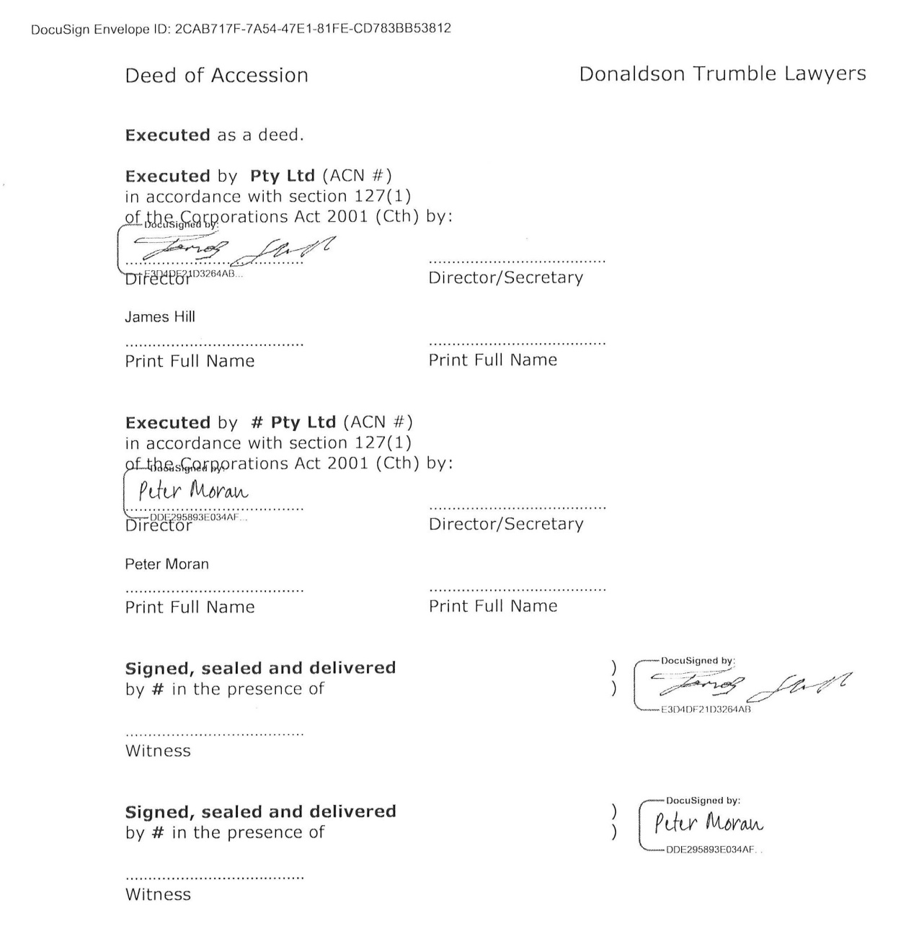
Signing software cont.

Slide 23
Retention
Sections 12(2) ETA Cth and 11(2) ETA Vic.
The information must remain complete and unaltered (section (3)).
Sections 12(4) and 11(4) ETA Vic, same applies for electronic communication (and the information must remain complete and unaltered – subsection (5)).
Arguably, the printing of an email with attachments whereby the attachments are not clearly identified or stored with the email means subsection (5) is not being met.
Metadata retention.

Slide 24
Online protection and privacy
The internet and email are inherently insecure: Lavabit, PRISM, Wiki-leaks.
Your ISP (and your recipient’s ISP) can examine all the data you send and receive via the internet as a side effect of providing your internet connection. Your email provider (and your recipient’s email provider) can examine all your email simply as a side effect of providing your email service.
Security is inversely proportional to useability: eg Tor, multi-factor authentication.

Slide 25
Online protection and privacy
Wi-fi hotspots.
BYOD and Passcodes.
Meta-data retention.
Security of signing software companies. Eg. Docu-sign, encryption, not accessible by staff, no rights to data granted to company.

Slide 26
Enforceability
Does the paperless contract provide clear evidence of the parties’ intention to be bound by its terms?
Has the offeror stipulated a method of communicating acceptance that precludes doing so electronically? Eliason v Henshaw 4 Wheaton 225 (1819) (send answer by same wagon not mail).
The “Postal Acceptance Rule” in a paperless world?

Slide 27
Enforceability cont
Evidence Act 2008 (Vic) and Evidence Act 1995 (Cth):
  The “original document” rule abolished as regards proving the contents of a document (section 51). A copy can be adduced including a copy that has been produced by a device that reproduces the contents of documents (section 48). See also section 146.
  Section 161 of Evidence Act 1995 (Cth).

Slide 28
Enforceability cont
161 Electronic communications
(1) If a document purports to contain a record of an electronic communication other than one referred to in section 162, it is presumed (unless evidence sufficient to raise doubt about the presumption is adduced) that the communication:
(a) was sent or made in the form of electronic communication that appears from the document to have been the form by which it was sent or made; and
(b) was sent or made by or on behalf of the person by or on whose behalf it appears from the document to have been sent or made; and
(c) was sent or made on the day on which, at the time at which and from the place from which it appears from the document to have been sent or made; and
(d) was received at the destination to which it appears from the document to have been sent; and...

Slide 29
Exceptions
In Victoria, a will, codicil or any other testamentary trust instrument is exempt from s7(1) – regulation 6(1) of the Electronic Transactions (Victoria) Regulations 2010.
Section 7(1) of the Wills Act 1997 (Vic) requires that a will be in writing, signed by the testator in the presence of two or more witnesses present at the same time who also sign in the presence of the testator.
Sections 9 & 10 not carved out. Problem with “in the presence of”.

Slide 30
Exceptions cont.
The “transaction is not invalid through being an electronic communication” rule of section 8(1) of the ETA Cth is not applicable to a requirement of:
  the Australian Securities and Investments Commission Act 1989 (Cth);
  the Banking Act 1959 (Cth), but only as regards sub-section 13(1) (being APRA’s power to obtain information from an ADI by providing notice in writing) and sub-section 62(1) (being APRA’s power to require persons to provide information;
  the Cheques Act 1986 (Cth);
  the Corporations Law (but only section 8(1) – note section 127 of Corporations Act 2001 (Cth));

Slide 31
Exceptions cont.
  the Evidence Act 1995 (Cth), but only sections 161 and 162 which pertain to electronic communications, lettergrams and telegrams;
  the Insurance Acquisitions and Takeovers Act 1991 (Cth) but only section 73 which pertains to the Minister’s right to demand documents or information by serving a notice in writing on a person;
  the Insurance Act 1973 (Cth);
  the Life Insurance Act 1995 (Cth); and
  the Superannuation Industry (Supervision) Act 1993 (Cth). .

Slide 32
Lessons for paperless contracts
Consider adding a boilerplate provision to contracts which states that, in the event that the parties sign and exchange contracts electronically, the parties consent to the contracts being produced, signed and retained solely in an electronic form, provided that production, signing and retention otherwise complies with the relevant requirements of the Electronic Transactions Acts.
This ensures the contract satisfies ss 9(1)(d), 9(2)(d), 10(1)(d), 11(1)(e), 11(2)(e) of the ETA Cth and ss 8(2)(b), 9(1)(c), 10(1)(c), 10(2)(c) of the ETA Vic.
If not, ensure parties agree explicitly to method of execution and exchange.

Slide 33
Lessons for paperless contracts cont.
Be cognisant of the relevant jurisdiction. If it is not subject to Victorian or Commonwealth jurisdictions, may need to check the relevant Electronic Transactions Act for that State (for example, Queensland has a broader range of exemptions (eg the Fair Trading Act 1989 (Qld) than most other states)).
Where contract is being provided pursuant to a Commonwealth statutory obligation, ensure no exception applies.

Slide 34
Lessons for paperless contracts cont
With contracts subject to overseas jurisdictions, it is not unreasonable to expect the lawyer for the overseas party to provide confirmation of the legality and enforceability of the contract being produced, signed and exchanged in a solely electronic form. Note that many jurisdictions (such as US and Europe) have more advanced regimes on electronic contracting than Australia.
Don’t be afraid, be informed!
Questions

